Slide 1


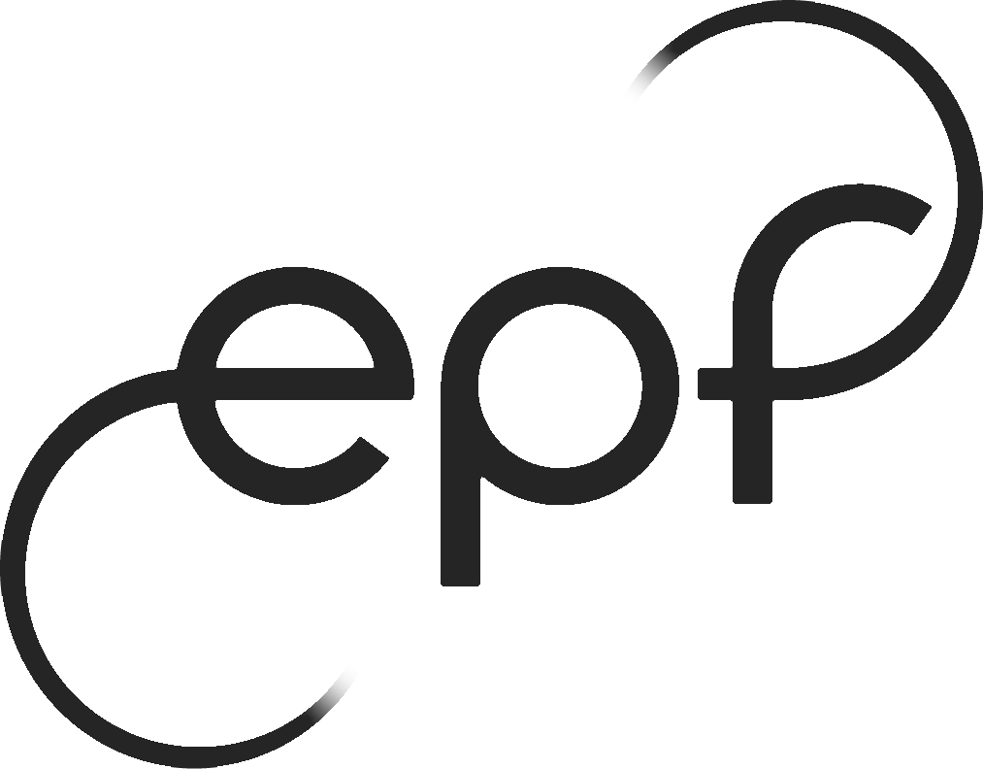
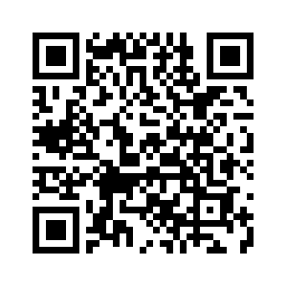
Top 50 Music From 2010-2019

Slide 2


Dance Pop Plays Octaves Higher Than Other Genres Whiles A Few Artists Leads The Rhythm Of The Industry
327
Music Genres by Number of Songs in the top 50
Canadian Pop
Barbadian Pop
Boy Band
Dance Pop
Pop
Top Artists by Number of Songs in the top 50
17
Katty Perry
16
Justin Bieber
15
Marron 5
60
15
Rihanna
34
15
15
14
Lady Gaga

Slide 3
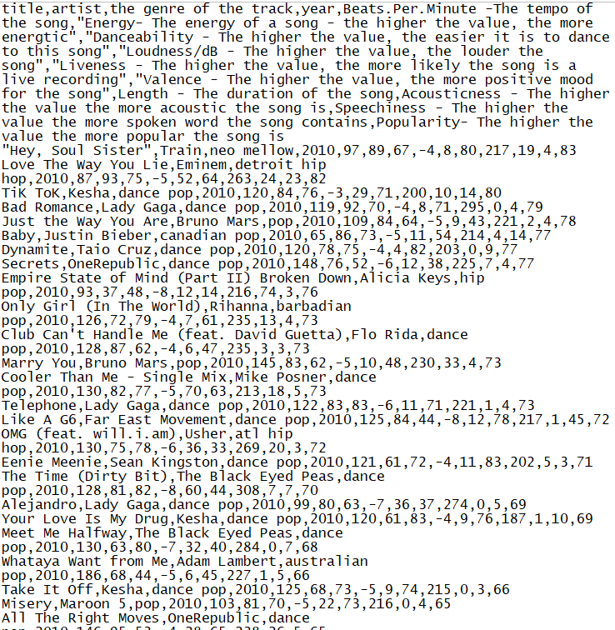
The Data
Found on github : https://gist.github.com/rioto9858/ff72b72b3bf5754d29dd1ebf898fc893#file-top50musicfrom2010-2019-csv
Dataset of top 50 Spotify music from 2010 to 2019. Originally published at Kaggle:Top Spotify songs from 2010-2019 - BY YEAR which is scraped from Spotify: Organize your music

Slide 4
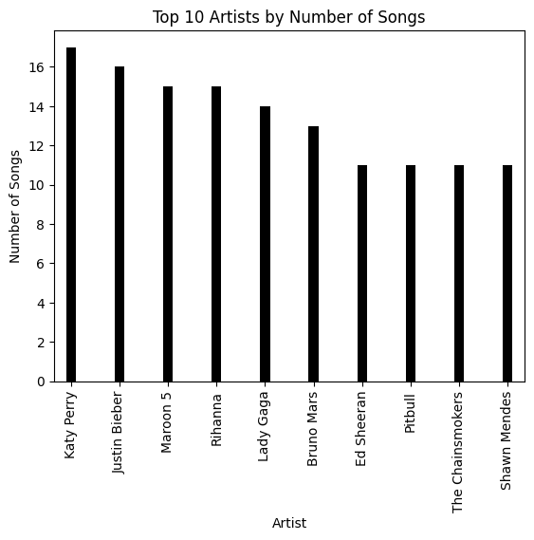
Top 10 artist
Only 184 different artists out of 584 different songs

Slide 5
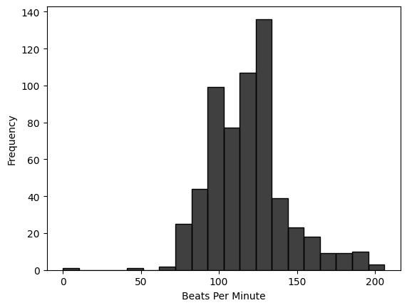
Tempo of the Song
Standard deviation is less than 25 bpm

Slide 6
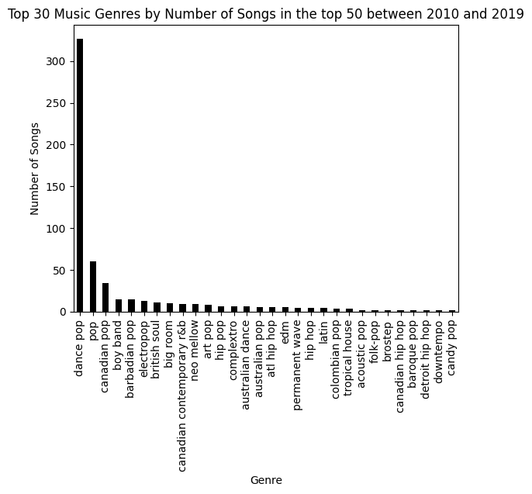
Top 30 genres
55,9 % of the songs are dance pop

Slide 7
Is Music Diversity Dead ?

Slide 8
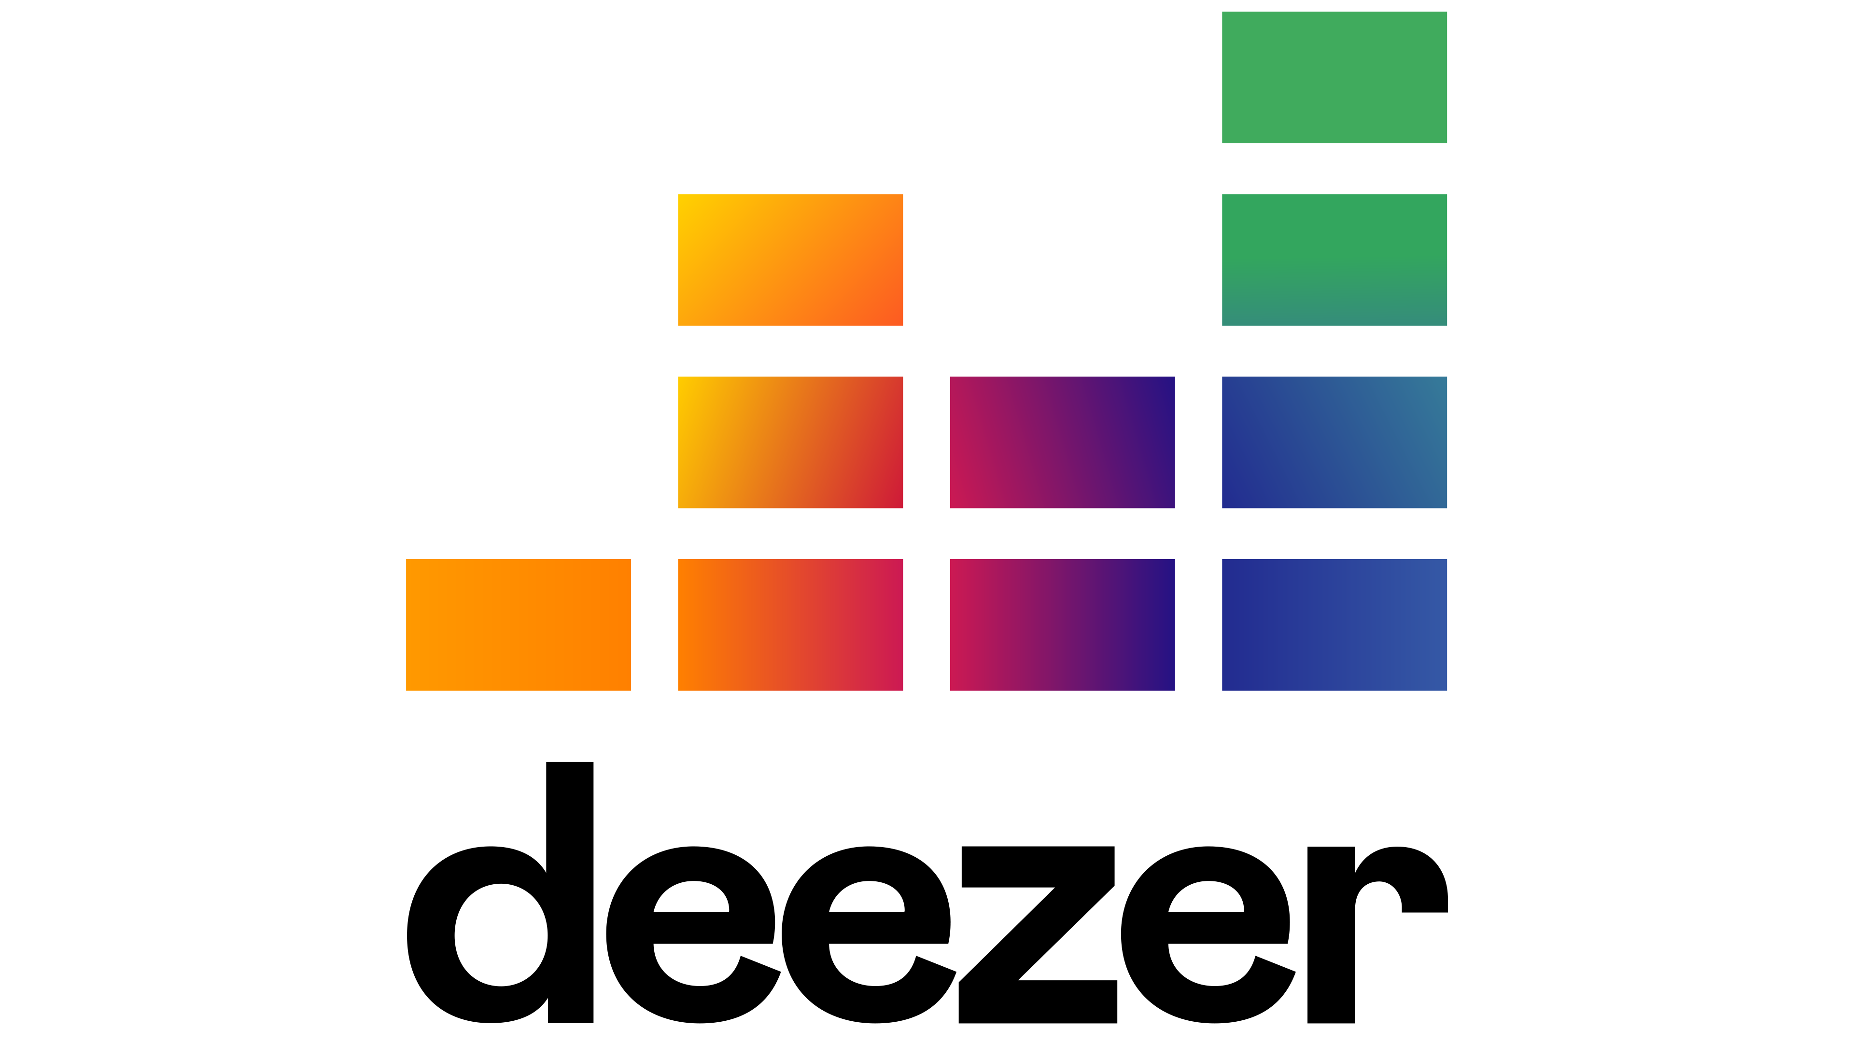





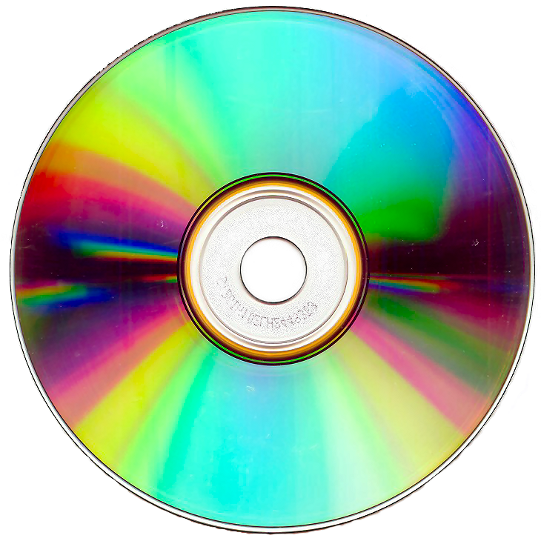
Different Habits Different Platforms Different Stats

Slide 9
Thanks For Your Attention
Melvyn ROLLAND

Slide 10

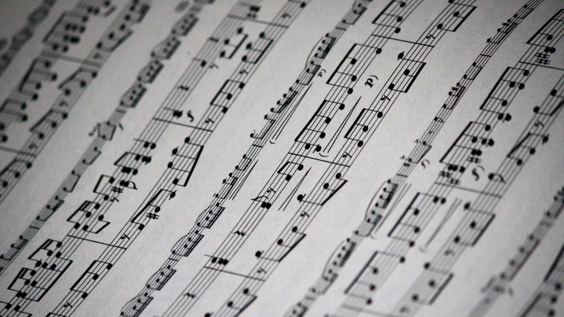
Thanks For Your Attention

Slide 11
Dance Pop Plays Octaves Higher Than Other Genres Whiles A Few Artists Leads The Rhythm Of The Industry
327
Canadian Pop
Barbadian Pop
Boy Band
Dance Pop
Pop
17
Katty Perry
16
Justin Bieber
15
Marron 5
60
15
Rihanna
34
15
15
14
Lady Gaga

